Slide 1

LSTM Acceleration with Singular Value Decomposition
Daniel Coble
dncoble@email.sc.edu
University of South Carolina
Department of Mechanical Engineering

Slide 2
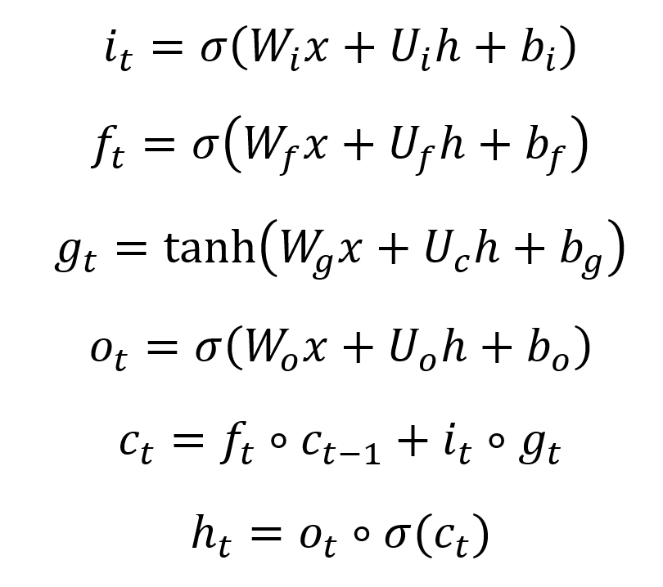
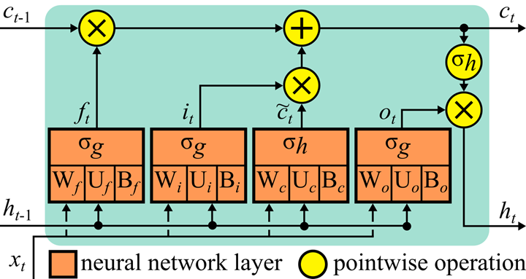
Background
Long-short term memory cells are a type of recurrent neural network governed by the below equations:

Slide 3
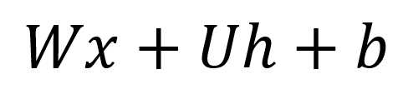
Background

Slide 4
Background
W: an n × m matrix
x: m input vector
U: an n × n matrix
h: n ‘hidden state’ or output vector
b: n bias vector
n: units of the cell

Slide 5
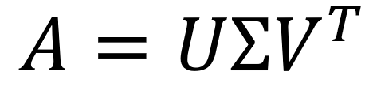

Background
The singular value decomposition is a decomposition of the matrix A into A = UΣV where U and V are orthogonal matrices and Σ is a diagonal matrix. It has the property that deleting trailing values in Σ will produce a matrix A that is the ‘closest’ matrix to A with rank reduced by 1.
σ
v
1
σ
v
2
σ
v
u
u
u
u
3
σ
v
r
r × n
r × r
m × r

Slide 6
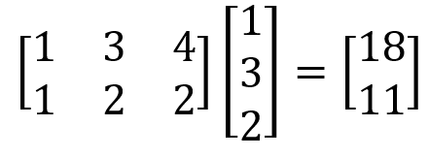
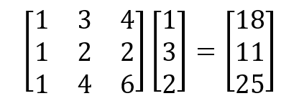


Methodology
We want to create a method which utilizes a rank reduction to improve the timing and reduce the size of the model. This is done by replacing matrix-vector multiplication with a two-step process.
⇒

Slide 7
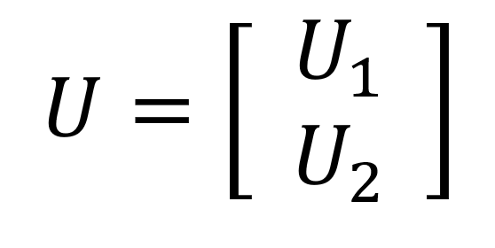
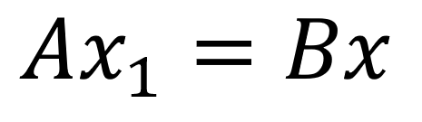
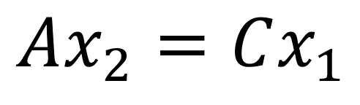
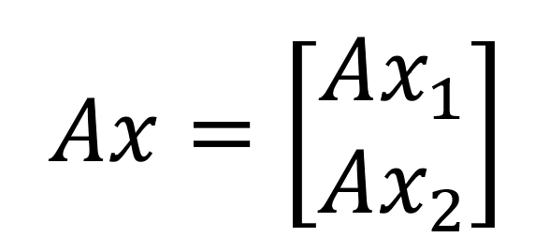
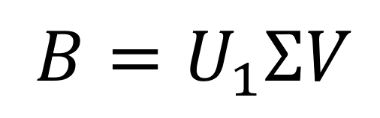
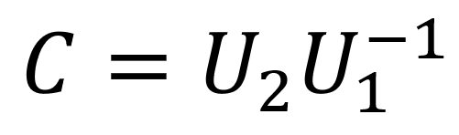
Methodology
U₁ is an r × r matrix.
is r × n
*
is (m - r) × r
*U₁ may not be invertible

Slide 8
Methodology - Time Complexity
We know that multiplication of an m × n matrix with an n × 1 vector is O(mn).
So the time complexity of a standard LSTM cell is O(max(m, n)n).
And the time complexity of a reduced two-step cell is
O(max(m, n - r)r).
m - input dimension. n - units. r - rank.

Slide 9
Methodology - Model Size
A standard LSTM cell has 4(mn + n² + n) weights.
A reduced two-step cell has 4(r(m + 3n - 2r)+n) weights if all matrices have the same rank. This is also 4(mn + n² + n - 2k²)
m - input dimension. n - units. r - rank. k - rank reduction.

Slide 10
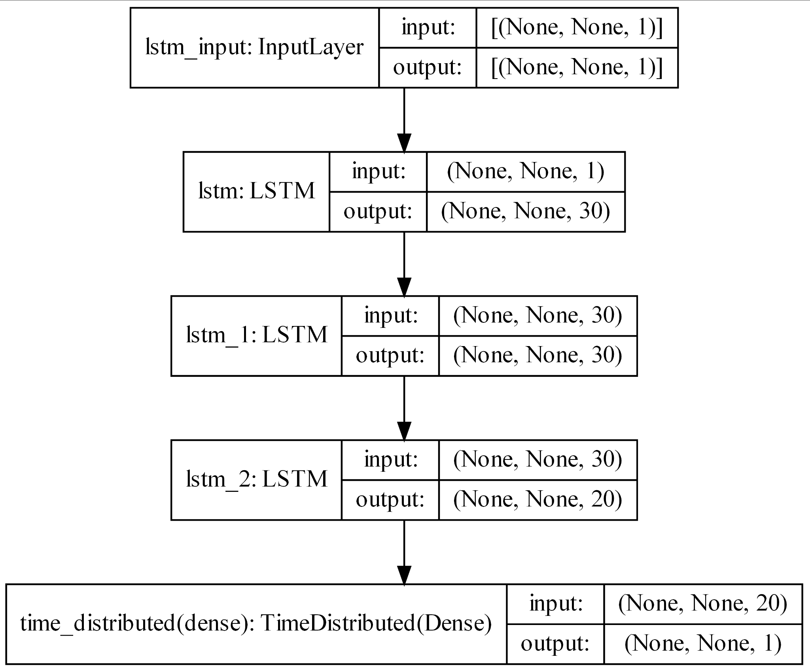
Results
I created an LSTM model with the shape given in the figure trained on the DROPBEAR dataset. LSTM layers 2 and 3 were transformed to reduced cells, and I measured the timing and error. Models are implemented using tensorflow.keras and linear algebra is performed with numpy.linalg.

Slide 11
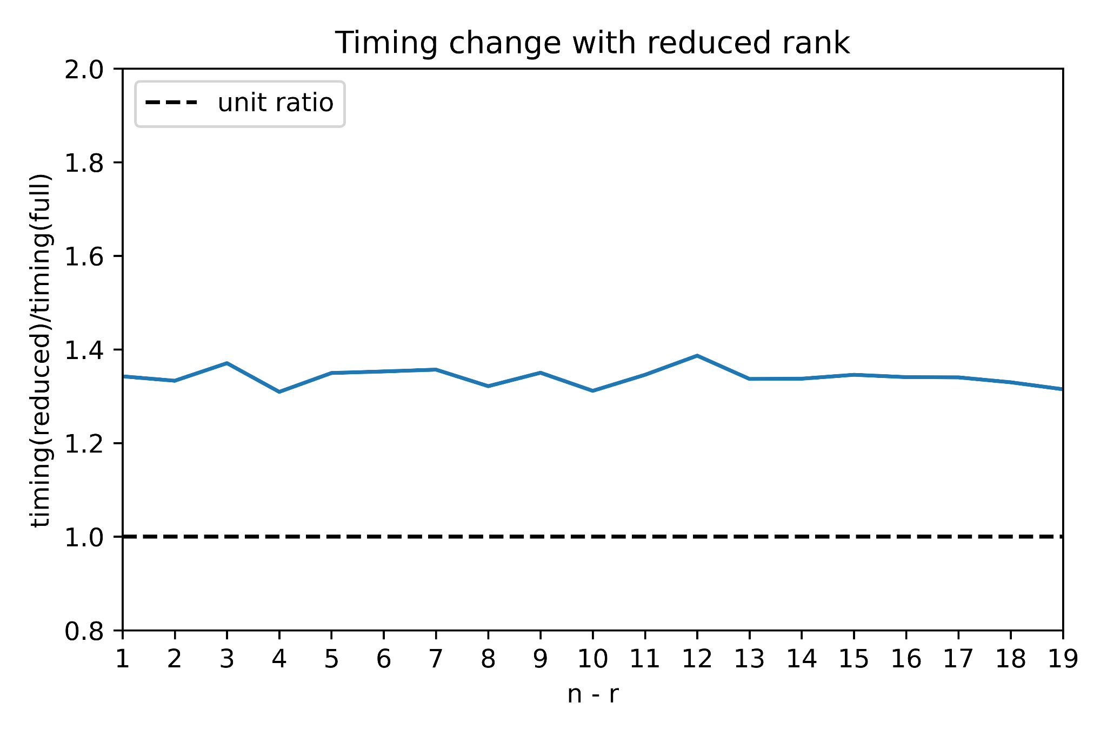
Results - Timing

Slide 12
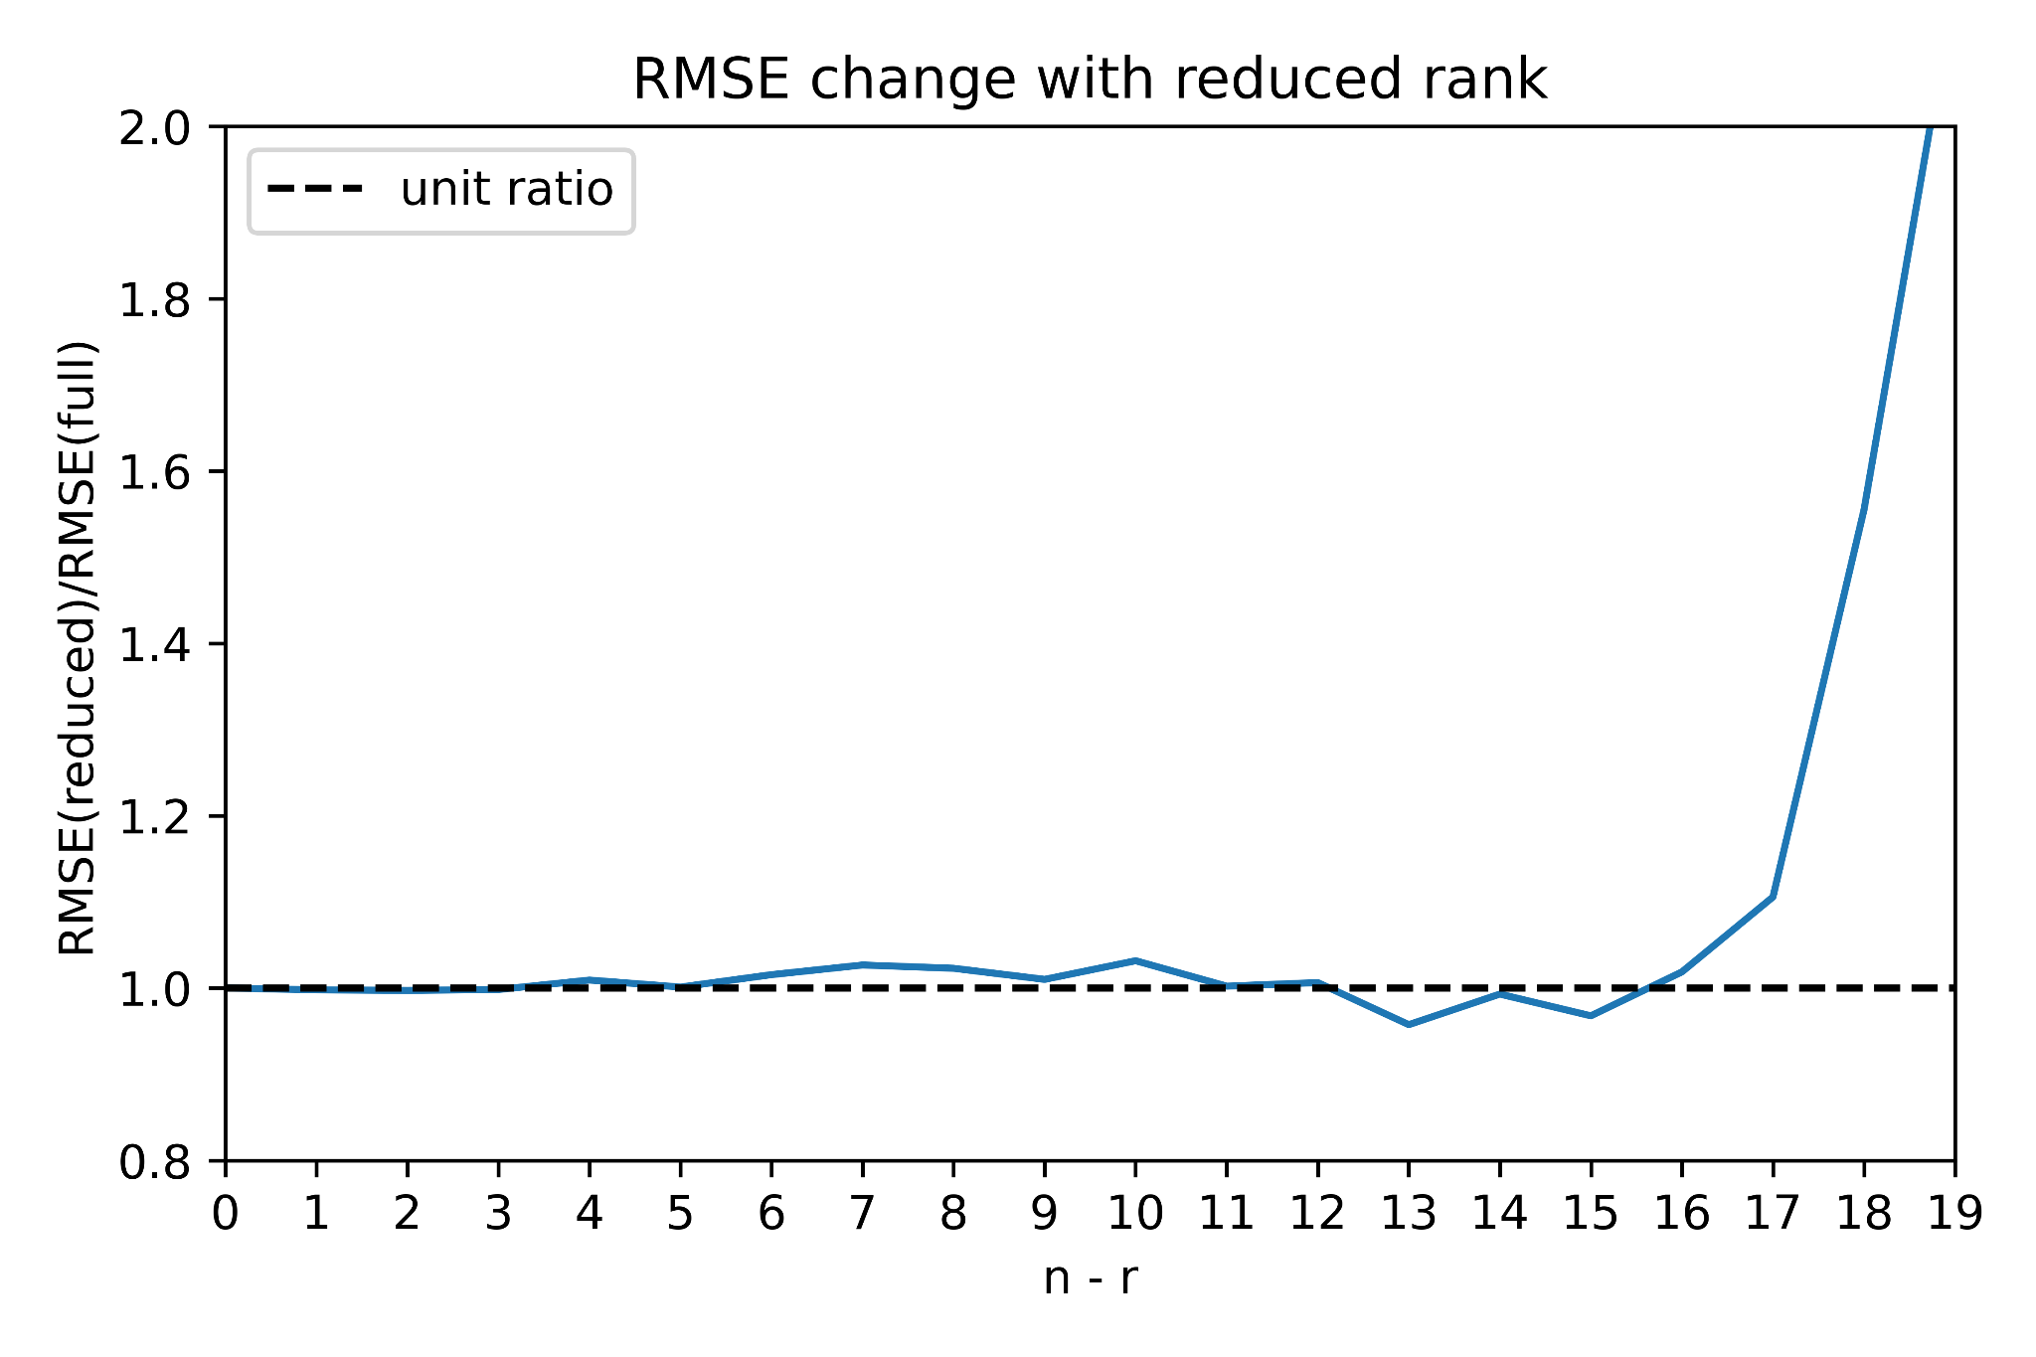
Results - Error

Slide 13
Results - Error
Model error remains constant until k = 15
The total amount of weights in cells 2 and 3 are 15260 for the full model and 13460 in the reduced model.
This corresponds to a decrease in size of 31.6%

Slide 14
Results - Error

Slide 15
Conclusion
Using this method, an LSTM cell can be significantly reduced before error is adversely affected.
This results in a modest decrease in model size.
The python model was not able to show a timing improvement with reduced models.
Future work: All matrices in all cells can be reduced by different amounts. Using different ks for each matrix could result in much better reductions to the model.

Slide 16
All of this work is on GitHub:
https://github.com/dncoble/LSTM-acceleration-with-singular-value-decomposition

Slide 17
THANK YOU

